Slide 1
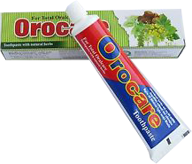
Management System for Orocare Toothpaste Company
Project Proposal
Group : ITP-2018-MLB-G1-08

Slide 2

Content Overview
Introduction
About Client
Problems and difficulties
Solutions
Benefits
System overview
Functions in detail
Tools and Technologies
Work breakdown structure

Slide 3

Introduction
A Toothpaste Company which has started recently.
Since the company has started in a small scale,
every part of the company’s business is managed
by manually.
The following company has now been gradually expanded.

Slide 4
Company finds difficulty in handling their work manually.
The company have 4 sales reps.
At the end of the day, the reps need to update the client (owner) with daily sales details.

Slide 5
What do they need?
In order to succeed with their expansion, Orocare is in a need for an automated system and is looking for IT services firm to perform the following:
Automate company’s employees details.
Automate company’s products details.
Automate company’s suppliers details.

Slide 6

Automate company’s stocks details.
Automate company’s salaries details.
Automate company’s orders details.
Automate company’s sales details.
So the solution proposed by us as IT students is to develop a system, that fulfills main aspects of the company’s management.
The proposed system consist of following 8 management systems

Slide 7
Main Functionalities
Order
Management
Product
Management
Employee
Management
Sales
Management
Order
Management
Employee
Salary
Management
User
Management
Supplier
Management
Stock
Management
The following management systems ensures that the company’s details are managed, manipulated automatedly. Specially the system will keep the staff frequently updated…

Slide 8

So, what are the benefits ?
The client receives frequent sales information about his company
Concurrent access to database and real time information
Reduction of duplicated data
All the company’s work is fully automated

Slide 9


System Overview
Front End
Back End
Order
Management
User
Management
Stock
Management
Sales
Management
User Interface
(JAVA)
SQL , JAVA
MYSQL
Database
Emp Salary
Management
Product
Management
Employee
Management
Supplier Info
Management

Slide 10

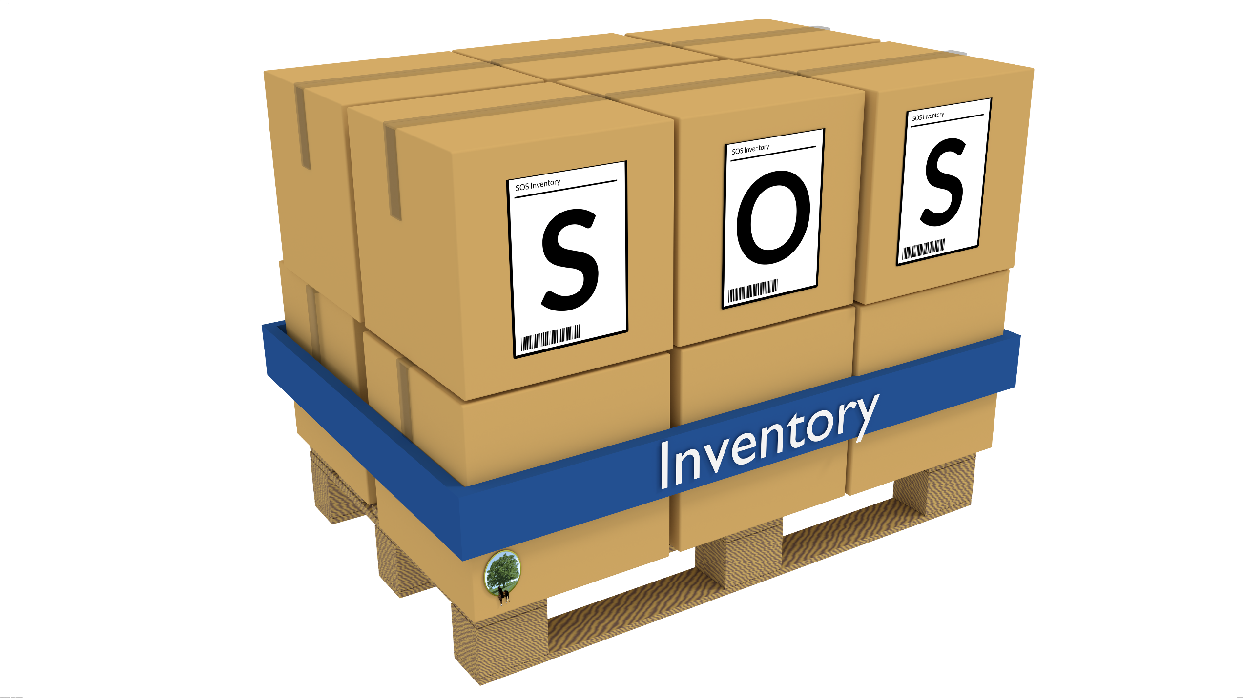






Order
Management
Stock
Management
Supplier Info
Management
Emp Salary
Management
Orocare Management System
Product
Management
Employee
Management
Sales
Management
User
Management

Slide 11

The main language used for developing the system is java.
Other technologies used, JAVA frames, MYSQL .
The system is developed as a standalone system .
Supposed to be deployed on client’s computer.

Slide 12
In the above diagram an overview of the system is show in simplest form.
There are different user levels in the system,
The admin has the access to all the mentioned management
system.
The Sales Representative has the access only to the Sales
Management, Employee Salary Management and
User Management.
The Employee has the access only to the Employee Salary
Management and User Management.

Slide 13
Since the admin cannot handle all the management systems concurrently he can give access to employees as he desire.
All the users in the system deals with the system via the User Interface which is designed using Java Frames.
All the core modules of the system are connected to the database.

Slide 14


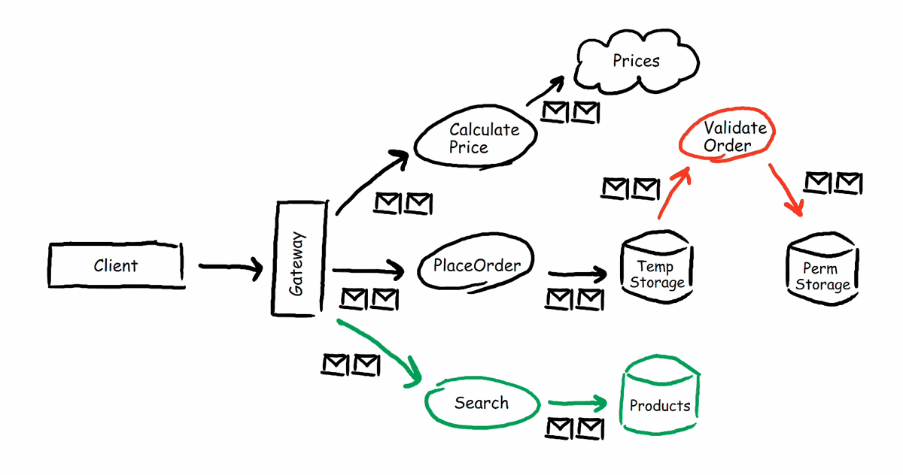
System Functions in detail….

Slide 15
This module is the main module in the system.
One of the main tasks of this module is to give different user levels for users.
The admin is capable of granting permission to users according to his desire.
Functions such as registering users, login include in this module.
User
Management

Slide 16
An Employee of the company can login to the system using his NIC and Employee ID.
If the Admin wishes to give permissions to an employee, the employee should submit a request to the admin, and upon the approval of the admin the employee can access restricted modules.
A user can maintain his personal details and update them according to his wish.
Admin also can track user activities such a logged in time, logged out time.
User
Management

Slide 17
Keep track of the stock by inserting records of the items of the company into the system.This is been done by a valid privileged user.
In addition to inserting new records, the user can also update the existing records if any change has to be made due to various reasons.
The user can also delete the unwanted stock item records if needed.
The stock information viewing function is also included to view the new and updated item records when needed.
Stock
Management

Slide 18
All the stock item records are been stored in the system database.
The user would be able to keep records off all the information on each item such as quantities, their expiry dates, manufacturers, prices, etc.
The user will be notified, if the items of the stock is running out (getting low in quantities).
Finally the user can be able to take a report of the stock management of its company including all of its details.
Stock
Management

Slide 19
Keep track of the Product details by inserting records of the products, which is produced by the company into the system.This would be done by a valid privileged user.
In addition to inserting new records, the user can also update the existing records if any change has to be made due to various reasons.
The user can also delete the unwanted or old product detail records if needed.
The product information viewing function is also included to view the new and updated product detail records when needed.
Product
Management

Slide 20
All the product item records are been stored in the system database.
The user would be able to keep records off all the information on each product such as name, ingredients, price, etc.
Finally the user can be able to take a report of the items management of its company including all of its details.
Product
Management

Slide 21
Maintains the sales information of the company.
Keep track of the sales by inserting records of the new sales of the company into the system.This is been done by the sales representatives.
In addition to inserting new records the sales representative can also update.
The existing records if any change has to be made due to various reasons.
The sales representative can also delete the unwanted sales records if needed.
Sales
Management

Slide 22
A sales viewing function is also included to view the new and updated sales records when needed.
All the sales records are been stored in the system database.
Database keeps record of information such as
id, type, price, quantity of the product sold.
Sales
Management

Slide 23
Keep and manipulate the salary details of all employees by inserting records of the employees and their salary details including EPF, ETF, other funds into the system.This is been done by a valid privileged user.
In addition to inserting new records, the user can also update the existing records if any change has to be made due to various reasons.
The user can also delete the unwanted records if needed.
Employee Salary
Management

Slide 24
Employee salary information viewing function is also included to view the new and updated records when needed.
All the salary records of employees are been stored in the system database.
Finally the user can print a salary slip and view salary reports.
Employee Salary
Management

Slide 25

Keep and manipulate the Supplier Information details of all suppliers by inserting records of the suppliers.
In addition to inserting new records, the user can also update the existing records if any change has to be made due to various reasons.
The user can also delete the unwanted records if needed.
Supplier Info
Management

Slide 26
Supplier information viewing function is also included to view the new and updated records when needed.
Supplier records of employees are been stored in the system database.
Supplier Info
Management

Slide 27
Maintains the employers’ information of the company.
Keep track of the employees by inserting records of the new recruited employees of the company into the system.This is been done by the staff manager.
In addition to inserting new records the staff manager can also update the existing records if any change has to be made due to various reasons.
The staff manager can also delete the unwanted sales records if needed.
Employee
Management

Slide 28
Maintains the order information of the company.
Keep track of the orders made by customers. This is done by inserting records of the orders placed by the customer into the system.The order management representative is responsible for inserting the records of the orders.
In addition to inserting new records the order management representative can also update the existing records if any change has to be made due to various reasons.
Order
Management

Slide 29
The order management representative can also delete the unwanted order records if needed.
An order viewing function is also included to view the order records when needed.
All the order records are been stored in the system database.
Database keeps record of information such as order ID, customer ID, customer name, order date, product name, unit price of product, no. of items ordered, discounts, total price of the order.
Order
Management

Slide 30
Tools and Technologies we used
Tools
Technologies
Eclipse IDE
XAMPP Server
JAVA libraries
The system is developed as standalone system,
which is supposed to be deployed on client’s computer.
Java
Java Frameworks
Mysql
Sql

Slide 31
Work Breakdown Chart
Function | Registration No | Name
User Management | IT17042352 | P.P.G.S.H.A.Guruge
Stock Management, User login | IT17052498 | Jayawardena J.K.S.L
Product Management | IT17048088 | Nirathanka O.R.M
Sales Management | IT17051644 | Illandara T.S
Employee Salary Management | IT17024464 | Perera D.J.R
Employee Management | IT16037816 | Weerasooriya M.N.H
Supplier Information Management | IT16003606 | Serasinghe N.H
Order Management | IT17028288 | Gunatileka B.R.I.S

Slide 32

Q & A Session…..
Q & A Session…..

Slide 33
The END
The END
Thank You!

